Slide 1
Statements

Slide 2
Remove Code from Functions

Slide 3

Function
Basic Function
Return type
Argument List
Member Function
Return type
Argument List
Notes:
Function 의 예제

Slide 4
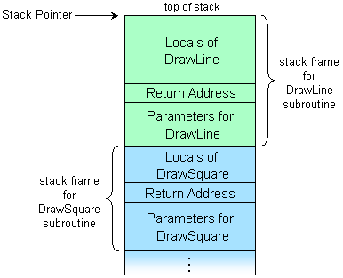
Function Call
Execution Address
DrawSquare(p1, p2, p3, p4); …
3. Current exec. Addr. copied
1. Make new frame
4. Execution address moved
2. Arguments copied
6. Exec. Addr. Moved
DrawSquare(p1, p2, p3, p4){ … DrawLine(p1, p2); … }
5. Exec
7. Pop Out

Slide 5
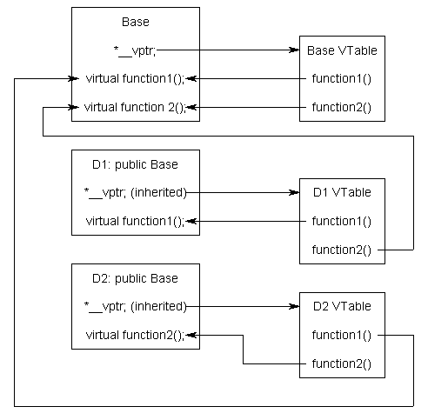
Functions
Basic Functions
Member Function Calls
Virtual Functions
Pointers to Functions
Arguments Copy
Call and Return
Hidden Arguments “this”

Slide 6
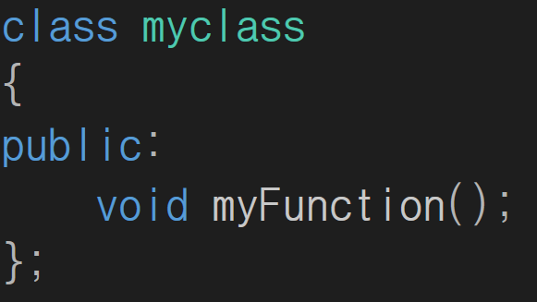
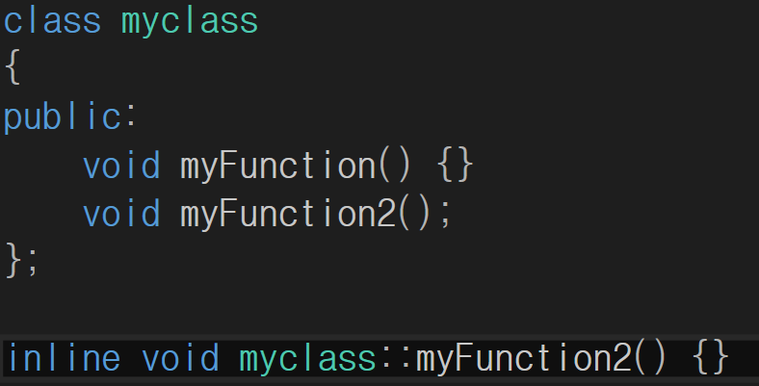
Brief Functions Inline
Notes:
Debug versus release builds in visual studio: debug builds turn off function inlining

Slide 7
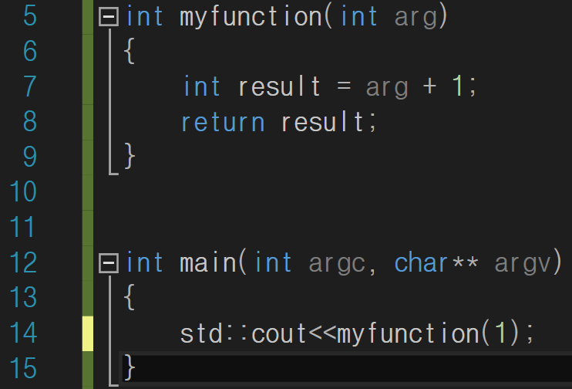
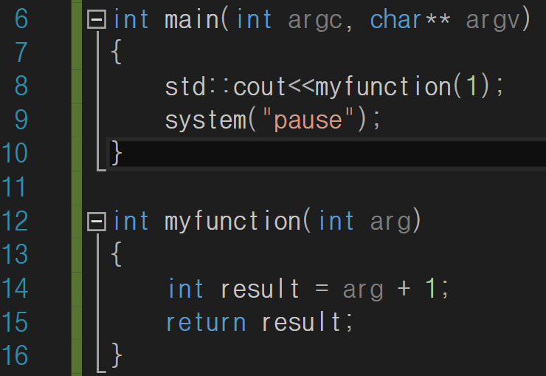
Define Functions Before First Use

Slide 8
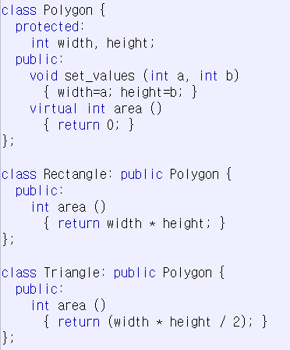
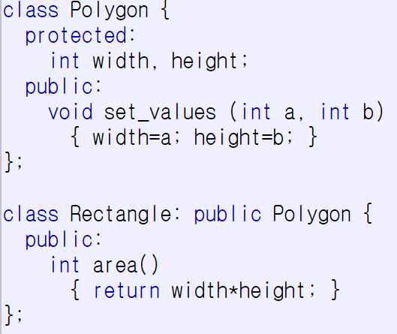
Eliminate Unused Polymorphism

Slide 9
Discard Unused Interfaces
Base Class
Derived Classes
2

Slide 10


Select Interface Implementation at Link Time
file.h
windowfile.cpp
linuxfile.cpp

Slide 11
Select Interface Implementation at Compile Time
Visual Studio
GCC

Slide 12
Eliminate Uses of the PIMPL Idiom
Pointer to IMPLementation

Slide 13
Miscellaneous
Eliminate Calls into DLLs
Use Static Member Functions Instead of Member Functions
Move Virtual Destructor to Base Class

Slide 14
Optimize Expressions

Slide 15
Expressions
Data Types (integer, float, double)
Integer<double<(?)float
+, *, /, -
+(-) < * < /

Slide 16

Simplify Expressions
$y=ax^{3}+bx^{2}+cx+d$
$y=a∗x∗x∗x+b∗x∗x+c∗x+d$
$y=\left(\left(\left(a∗x+b\right)∗x\right)+c\right)∗x+d$
Horner’s Rule

Slide 17
Group Constants Together

Slide 18
Use Less-Expensive Operators
+(-)<*</
(x*4)
->(x<<2)
Decent compiler Does this for you
x*y? x*func()?
x*9?
(x<<3)+x

Slide 19
Use Integer Arithmetic Instead of Floating Arithmetic
Floating Arithmetic Cost>Integer Arithmetic Cost
Repeat 100 million times: 3125ms
Repeat 100 million times: 435ms (6x)

Slide 20
Use Integer Arithmetic Instead of Floating Arithmetic
Floating Arithmetic Cost>Integer Arithmetic Cost
Repeat 100 million times: 3125ms
Repeat 100 million times: 135ms (22x)

Slide 21
Use Integer Arithmetic Instead of Floating Arithmetic
Floating Arithmetic Cost>Integer Arithmetic Cost
Repeat 100 million times: 3125ms
Repeat 100 million times: 102ms (30x)

Slide 22
Double vs Float
Visual C++ Env.
Visual C++
Floating point operation at
X87 FPU coprocessor (80-bit)
10 million: 1889 ms
2x
10 million: 989 ms

Slide 23
Iterative Comptuations to Closed Form

